Slide 1
Plotting with matplotlib and Data Normalization
Dr. Kavita S. Oza

Slide 2
Introduction
A low level graph plotting library in python that serves as a visualization utility.
Open source
Provides objected-oriented APIs for integrating plots into applications.
It is not a part of the Standard Libraries which is installed by default while installing Python.
The pyplot submodule, imported under the plt alias:
import matplotlib.pyplot as plt
Various plots which can be created using python matplotlib.

Slide 3
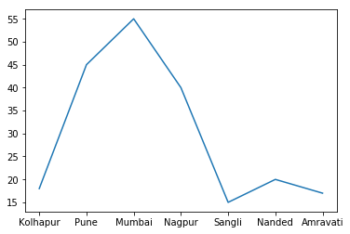
Data visualization
Example, a house of 1000 sq. ft. predicted to sell in the range of 15 to 55 lakhs , depending on the city where it is located.
City | house value in lakhs
Kolhapur | 18
Pune | 45
Mumbai | 55
Nagpur | 40
Sangli | 15
Nanded | 20
Amravati | 17

Slide 4
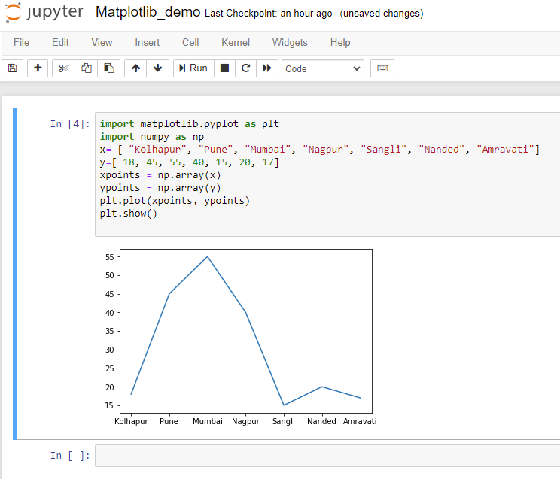
Example

Slide 5
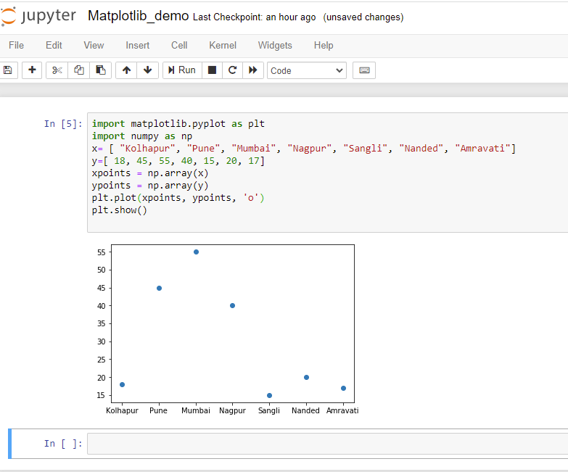
Plotting only the markers: string notation parameter 'o‘ or ‘*’

Slide 6
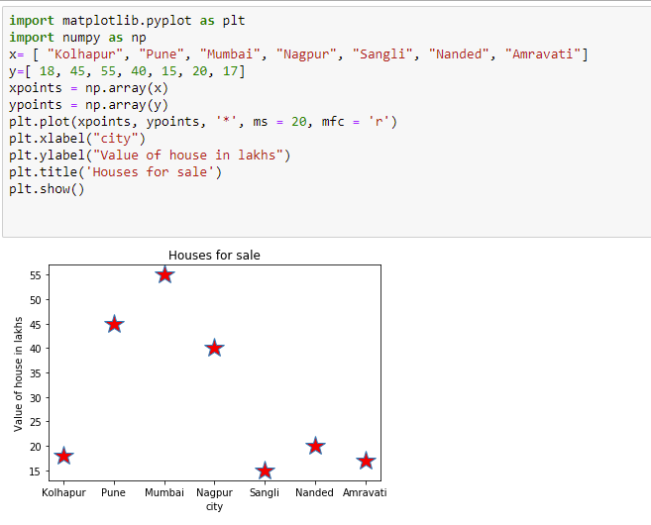
Adding title, x-axis and y-axis label
ms= marker size
mfc = marker face color (to set the color inside the edge of the markers)

Slide 7
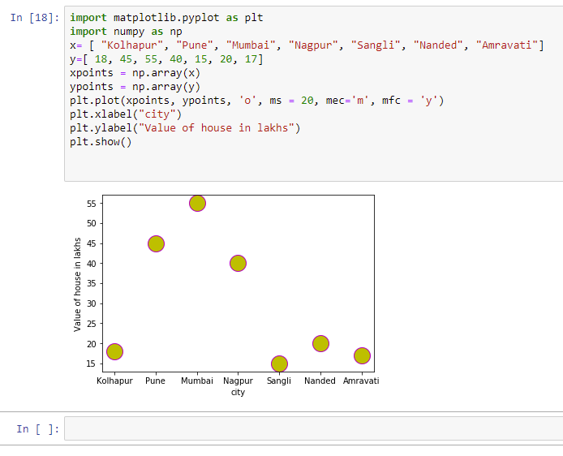
Changing marker edge color
ms: Marker size
mec: marker edge color
mfc : marker face color

Slide 8
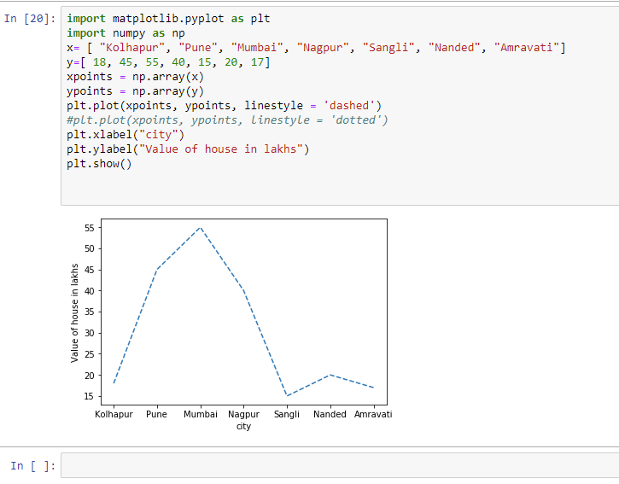
Printing dashed line graph

Slide 9
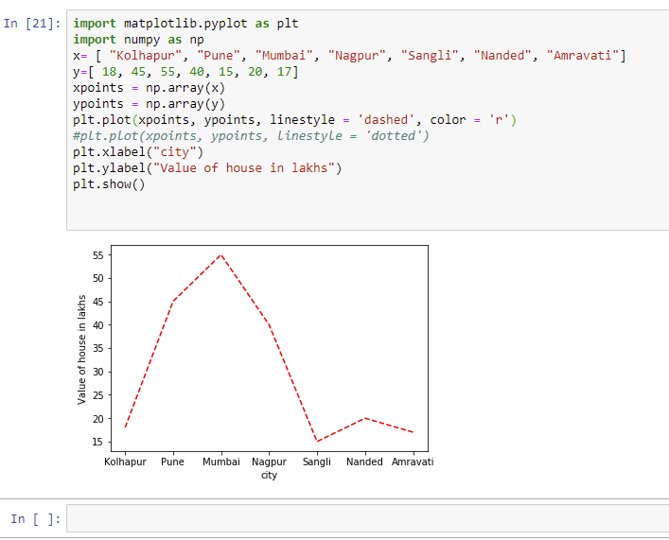
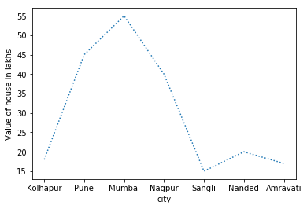
Change the style and color of the plotted line
plt.plot(xpoints, ypoints, linestyle = 'dotted')

Slide 10
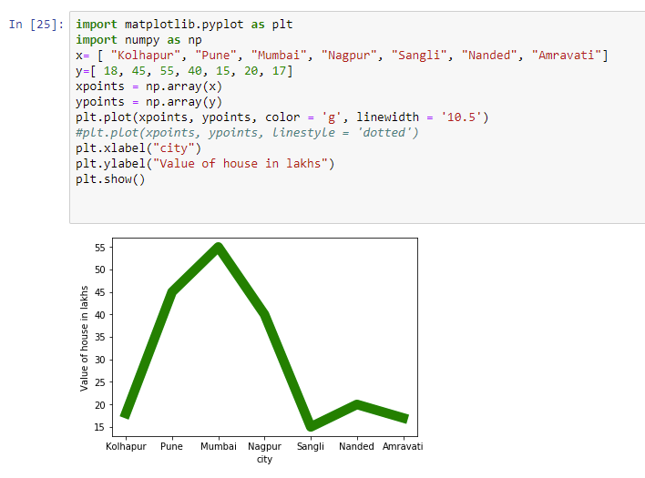
Line Width

Slide 11
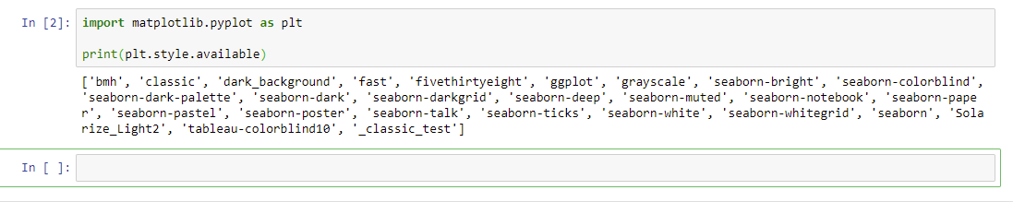
Styles
from matplotlib import style
style.use('ggplot')

Slide 12
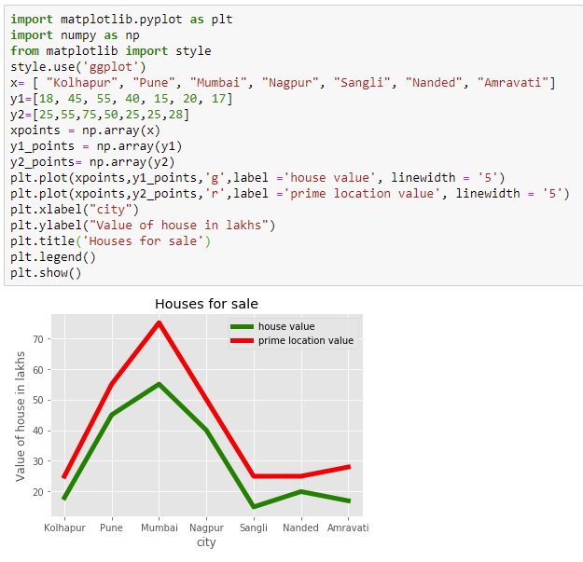
Plotting Multiple Lines
City | Value in lakhs | Prime location
Kolhapur | 18 | 25
Pune | 45 | 55
Mumbai | 55 | 75
Nagpur | 40 | 50
Sangli | 15 | 25
Nanded | 20 | 25
Amravati | 17 | 28

Slide 13
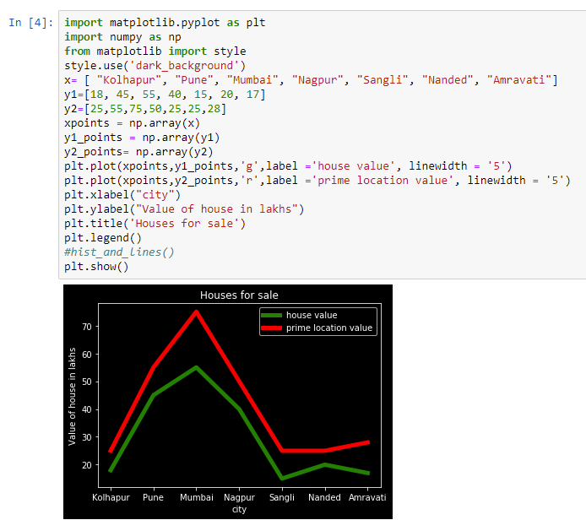
style.use('dark_background')

Slide 14
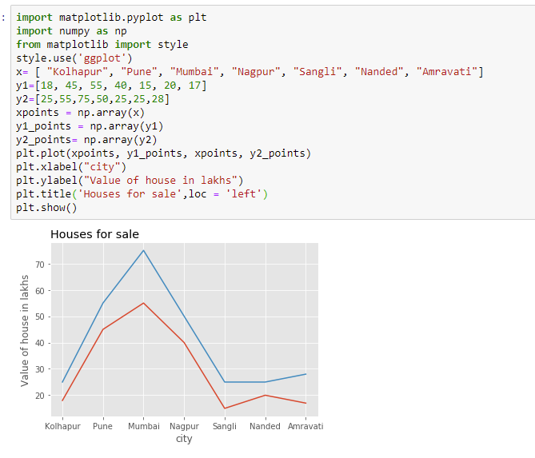
Plotting many lines with single plot function

Slide 15
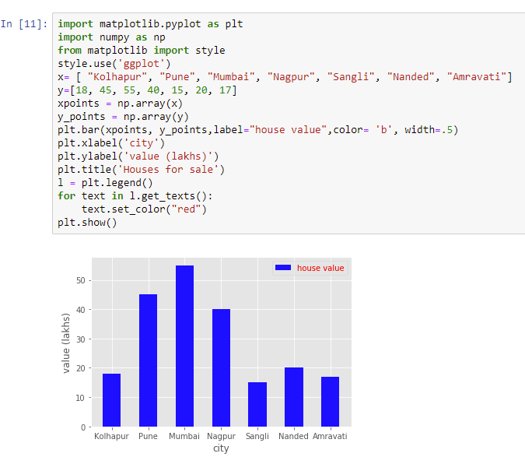
Bar Graph
City | house value in lakhs
Kolhapur | 18
Pune | 45
Mumbai | 55
Nagpur | 40
Sangli | 15
Nanded | 20
Amravati | 17

Slide 16
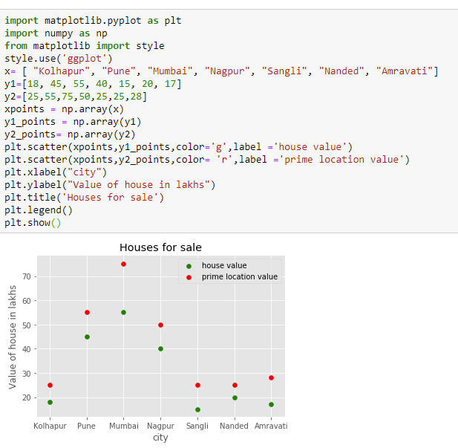
Scatter graph
City | Value in lakhs | Prime location
Kolhapur | 18 | 25
Pune | 45 | 55
Mumbai | 55 | 75
Nagpur | 40 | 50
Sangli | 15 | 25
Nanded | 20 | 25
Amravati | 17 | 28

Slide 17
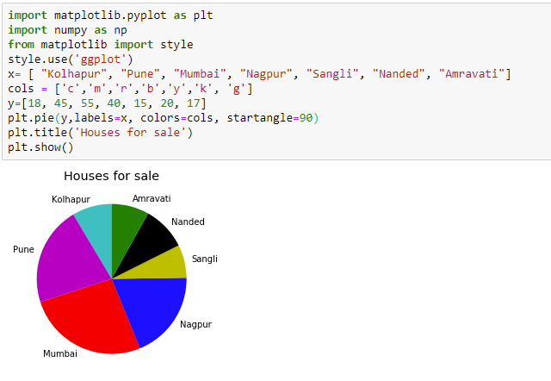
Pie Chart

Slide 18
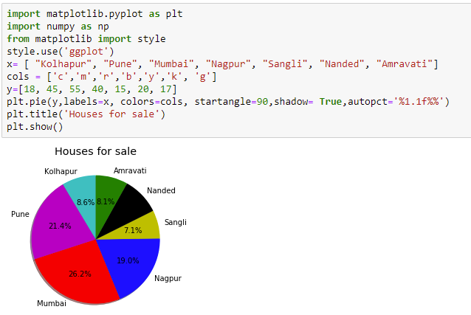
Bar chart showing the percentage or proportional data

Slide 19

Data Normalization
Machine learning algorithms tend to perform better when the different features (variables) are on a smaller scale.
Makes the training process less sensitive to the scale of the features.
Results in getting better coefficients after training.
Formula for Normalization:

Slide 20
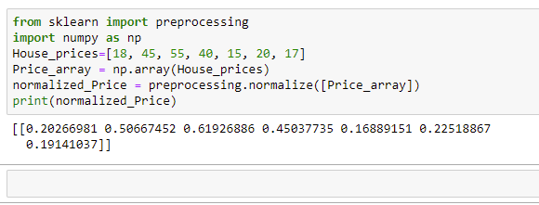
Using normalize() from sklearn
All the values are now between the range 0 to 1.
This method normalizes data along a row.

Slide 21
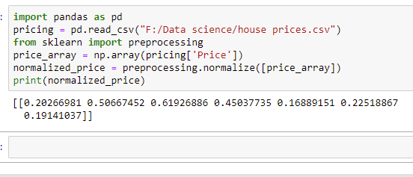
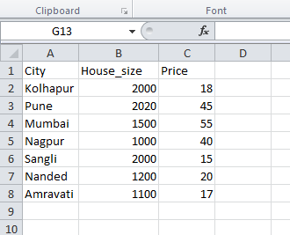
Normalizing columns in a dataset
Since normalize() only normalizes values along rows, need to convert the column into an array before applying the method

Slide 22
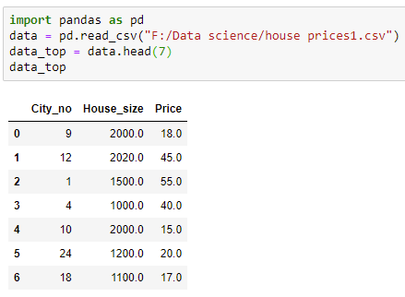
Normalizing a Dataset Without Array conversion
Dataset

Slide 23
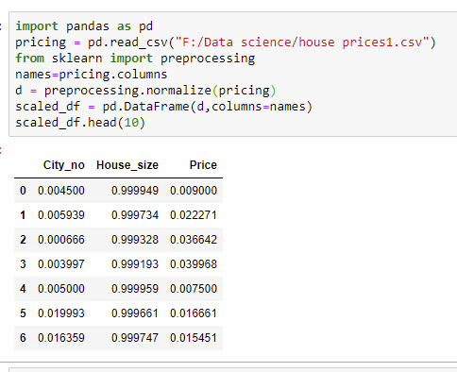
Normalizing a Dataset
Here the values are normalized along the rows. Normalizing along rows means that each individual record is normalized instead of the features.

Slide 24
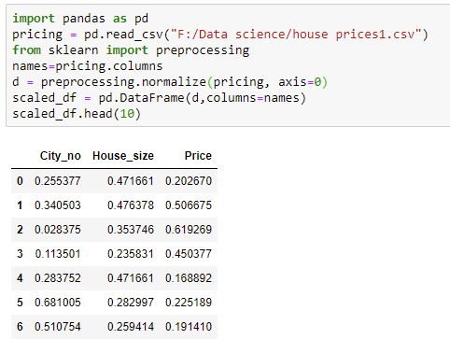
Normalizing a Dataset …
Specify the axis while calling the method to normalize along a feature (column).
The value of axis parameter is set to 1 by default. Change the value to 0, the process of normalization happens along a column.

Slide 25
Thank You

